Slide 1
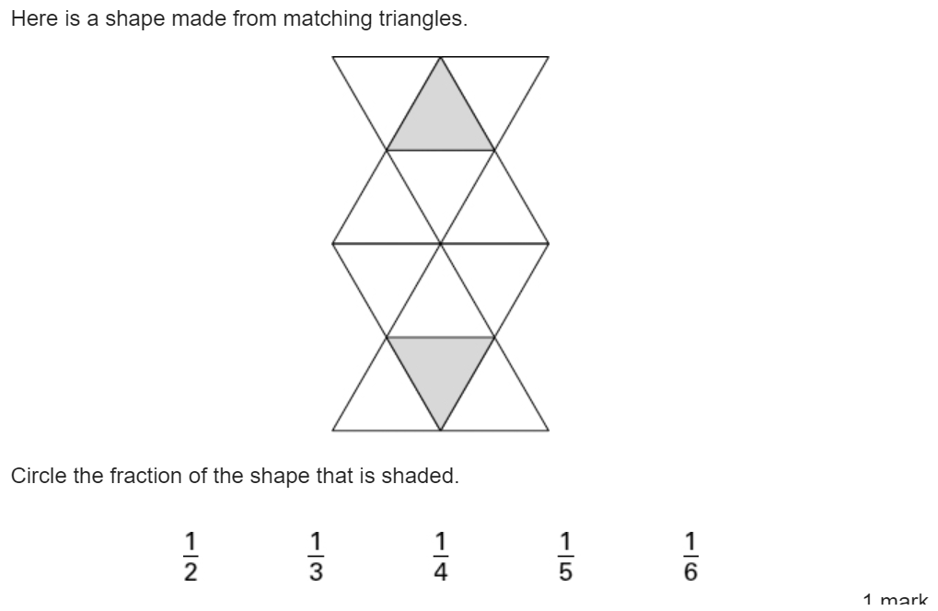
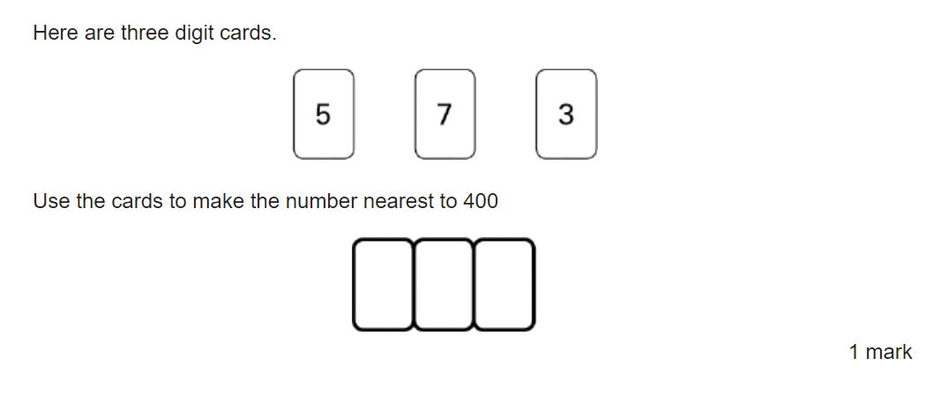
Welcome to the Year 3/4 Maths Parent Meeting 2023
Please keep yourselves on mute throughout this meeting.
Have a go at these test style questions whilst we wait to get started.

Slide 2
Mastery Approach to maths
Mastering maths means that the children are acquiring a deep, long-term, secure and adaptable understanding of the subject.
The phrase ‘teaching for mastery’ describes the elements of classroom practice and school organisation that combine to give St Mary’s children the best chances of mastering maths.
Achieving mastery means acquiring a solid enough understanding of the maths that’s been taught to enable pupils to move on to more advanced material.
Notes:
LW

Slide 3
Mastery Approach to maths
Acquiring mastery of mathematics is something for all pupils.
Teaching for mastery approaches can enable all pupils (with only a tiny proportion of exceptions) to succeed in maths.
Notes:
LW

Slide 4
Mastery Approach to maths
Whole class moves through content at the same pace
Time to think deeply about the maths
Builds self-confidence in learners
Differentiates through depth rather than acceleration
Fluency
Reasoning
Problem solving
Notes:
LR
Whole class moves through content at the same pace
When teaching maths for mastery, the whole class moves through topics at broadly the same pace. Each topic is studied in depth and the teacher does not move to the next stage until all children demonstrate that they have a secure understanding of mathematical concepts.
Time to think deeply about the maths
Students are given time to think deeply about the maths and really understand concepts at a relational level rather than as a set of rules or procedures. This slower pace leads to greater progress because it ensures that students are secure in their understanding and teachers don’t need to revisit topics once they’ve been covered in depth.
Builds self-confidence in learners
In a traditional primary school maths lesson, children are put in different groups and given different content based on their anticipated ability. This means that from an early age children are classed as those who can and can’t “do maths”. Teaching maths for mastery is different because it offers all pupils access to the full maths curriculum. This inclusive approach, and its emphasis on promoting multiple methods of solving a problem, builds self-confidence and resilience in pupils.
Differentiates through depth rather than acceleration
Though the whole class goes through the same content at the same pace, there is still plenty of opportunity for differentiation. Unlike the old model, where advanced learners are accelerated through new content, those pupils who grasp concepts quickly are challenged with rich and sophisticated problems within the topic. Those children who are not sufficiently fluent are provided additional support to consolidate their understanding before moving on.
Coherence - Lessons are broken down into small connected steps that gradually unfold the concept, providing access for all children and leading to a generalisation of the concept and the ability to apply the concept to a range of contexts.
Fluency - Quick and efficient recall of facts and procedures and the flexibility to move between different contexts and representations of mathematics
Driving a car analogy
Challenge
Support – manipulatives

Slide 5
White Rose lesson structure
Starts with Flashback 4
Notes:
LR
It is vital that we re-visit previously taught objectives so that the children retain the information they’re taught. Some objectives are only taught in one year group and never visited again.
It allows us as teachers to assess the children’s learning and more importantly, where there might be a gap in learning.

Slide 6
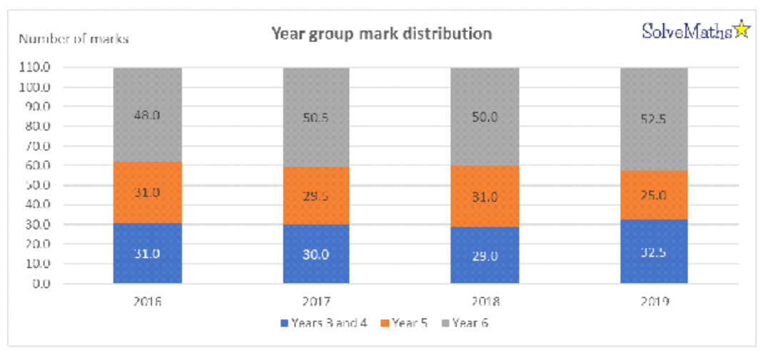
So why do we use flashback?
The 2019 papers had the greatest number of Year 3/4 curriculum content ever assessed.
Notes:
Laura to explain regarding SATs
Flashback
Lessons on prev objectives
Catch up sessions

Slide 7
It was interesting to see how many pupils correctly answered Paper 3, Q14 which assessed pupils’ knowledge on the days in a month – a year 3 objective
Notes:
LR

Slide 8
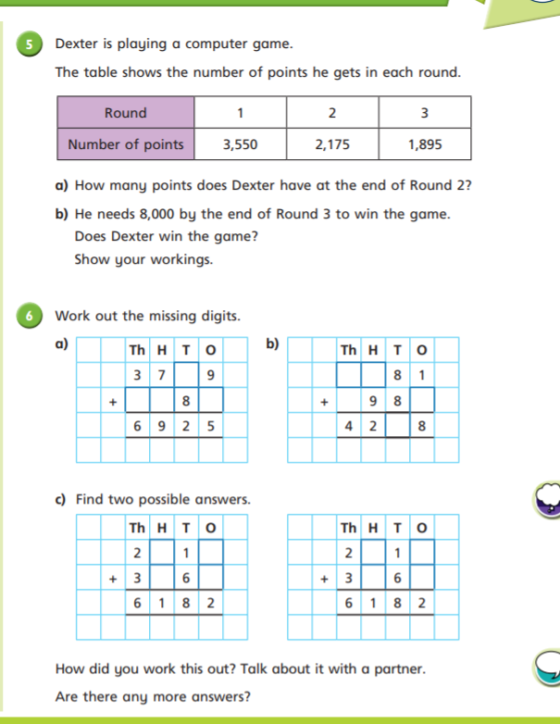
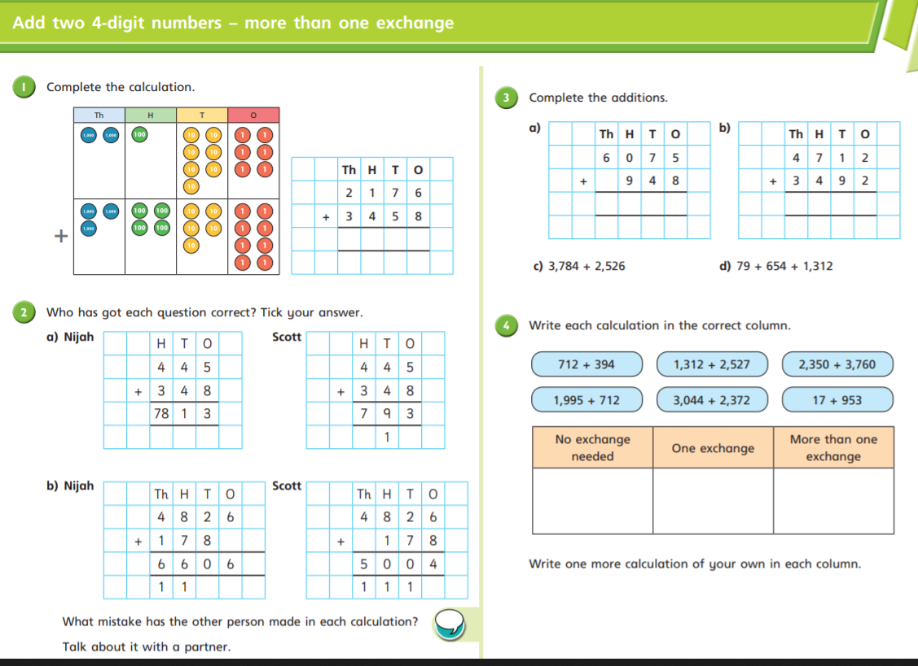
White Rose lesson structure
Notes:
LW
A new way of thinking and teaching.
This is the layout of a white rose lesson worksheet – all familiar from lockdown.
Important do what some might see as ‘easier skills’ so the fluency is kept fresh.
Move through reasoning and p solving question. Covers all types of questions mentioned on the graph before.
Support and differentiation through manipulatives and pictoral representations (q1)
Challenge through reasoning, p solving and then challenges where they deepen their understanding.
Extra challenges for those who finish.

Slide 9
Mental Maths
63 % of Y6 Arithmetic SATs paper 2019 could be answered using mental strategies. A much faster and efficient approach than written methods.
Notes:
LW

Slide 10
“It isn’t really a case of children choosing methods because they find them appealing or the easiest overall to do, but that they are being mindful in selecting the method that is the most appropriate for the particular numbers in a particular calculation.”
MINDFUL MATHEMATICS
Askew, M. (2012) Transforming Primary Mathematics, Routledge, p.70)
Notes:
LW

Slide 11
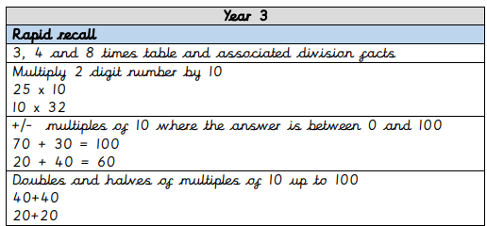
Notes:
LR Update with 3/4

Slide 12
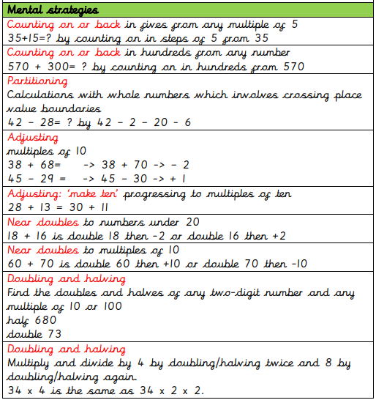
Notes:
LR Update with 3/4

Slide 13
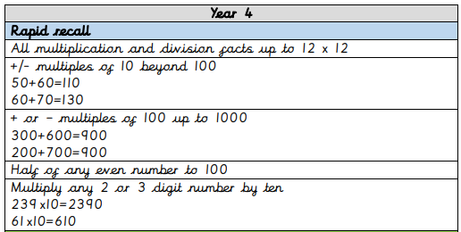
Notes:
LR Update with 3/4

Slide 14
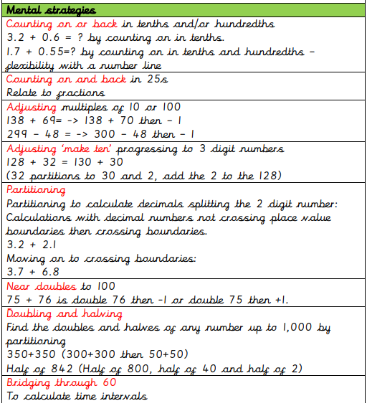
Notes:
LR Update with 3/4

Slide 15
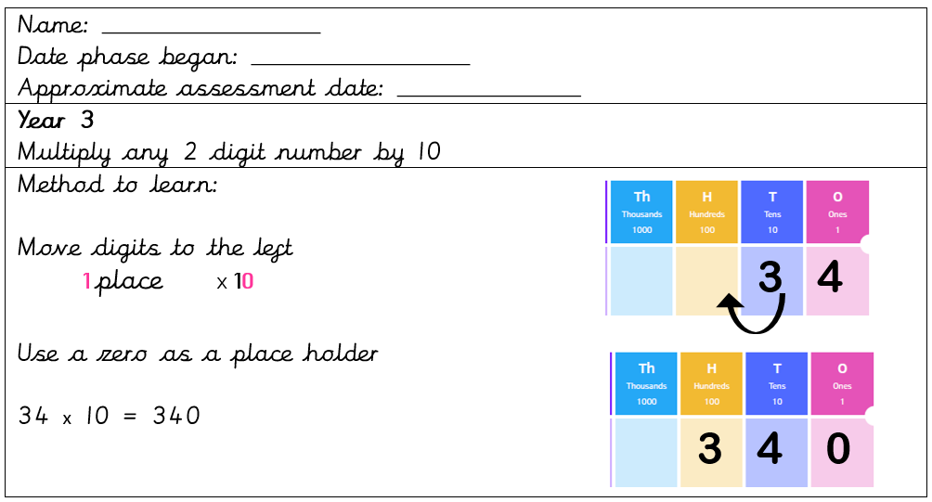
Notes:
LR Update with 3/4

Slide 16
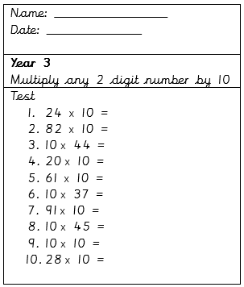
Notes:
LR Update with 3/4

Slide 17
What you could Focus on at Home
Year 3
4 operations
Times tables- TTRS
Place value
Year 4
4 operations
Times tables- TTRS
Decimals
Fractions
Notes:
LR and LW

Slide 18
Any questions?
Notes:
LW
MTC info next

Slide 19
Year 4 Multiplication Tables Check (MTC) 2023
Compulsory- 2 week period starting Monday 5th June 2023
On screen- answering multiplication questions against the clock
6 seconds to answer each question- 25 questions
From 2 to 12 times tables- focus on the 6, 7, 8, 9 and 12 times tables
No pass mark
Notes:
LW
Primary-school children are expected to know all their times tables up to 12x12. Under the current National Curriculum, children are supposed to know their times tables by the end of Year 4, but until now they were not formally tested on them other than through multiplication questions in the Year 6 maths SATs.
The DfE says that the check is part of a new focus on mastering numeracy, giving children the skills and knowledge they need for secondary school and beyond. The purpose of the MTC is to determine whether Y4 pupils can recall their multiplication tables fluently (being able to answer times tables questions accurately and quickly, without having to work out the answers)
Curriculum reform has meant there has been a raise in standards and we must have an assessment system to support this.
Each question will only appear once in any 25-question series, and children won't be asked to answer reversals of a question as part of the check (so if they've already answered 3 x 4 they won't be asked about 4 x 3).
Once the child has inputted their answer on the computer / device they are using, there will be a three-second pause before the next question appears. Children will be given the opportunity to practise answering questions in this format before the official check begins.
The six-second time limit per question has been decided on by the DfE because it should allow children enough time to demonstrate their recall of times tables without giving them the time to work out the answers to each question.
There will be no "pass mark" (expected standard threshold) and no child will "fail" the test. Multiplication facts will be the only things tested (there will be no testing of children's knowledge of division facts or problem-solving in the check).
The DfE says the purpose of the check is to help teachers identify which children are falling behind and target areas where they’re not being given a chance to succeed.
Pupils' individual results will be made available to schools. It's unlikely that children will be told their individual score, but schools will be required to report the results to parents or carers.
School-level results won't be made publicly available or be used in league / performance tables.

Slide 20
Any questions?
Notes:
LW

